Slide 1

Effective Communication with Individuals with Complex Needs
PT5051
Lubna Syed
This Photo by Unknown Author is licensed under CC BY-ND

Slide 2

Today's Presentation Agenda
Foundations of Advanced Communication in Physiotherapy
Understanding Complex Communication Needs
Barriers to Communication in Individuals with Complex Needs
Communication Strategies and Tools
Utilising Augmentative and Alternative Communication (AAC)
Ethical, Cultural, and Professional Considerations
Applying Evidence-Based Communication Frameworks
Adapting Communication for Individual Needs
Reflecting on Communication Style and Its Impact
Collaborative Communication with Teams and Carers

Slide 3

Key principles of therapeutic communication
Active Listening
  Engaging fully by listening attentively to patient concerns to build understanding and trust.
Empathy
  Demonstrating understanding and compassion to support patients' emotional and physical needs.
Clarity and Respect
  Communicating clearly and respectfully to foster engagement and cooperation during treatment.

Slide 4

The role of communication in physiotherapy outcomes
Enhances Patient Understanding
  Clear communication helps patients better understand their treatment plans and goals.
Improves Treatment Adherence
  Effective communication encourages patients to follow prescribed therapies consistently.
Increases Patient Satisfaction
  Good communication leads to higher patient satisfaction and trust in physiotherapy care.
Supports Rehabilitation Success
  Enhanced communication contributes to better rehabilitation outcomes and overall health improvements.

Slide 5

The importance of patient-centred care
Respecting Individual Preferences
  Patient-centred care honours unique patient needs and preferences to provide personalised healthcare.
Tailored Communication
  Effective communication is adapted to each patient to enhance understanding and collaboration.
Building Therapeutic Relationships
  Patient-centred approaches foster trust and motivation, improving health outcomes.

Slide 6

Defining complex needs: cognitive, sensory, emotional, and language barriers
Cognitive and Understanding Difficulties
  Complex needs often involve challenges in understanding information requiring tailored support methods.
Sensory Processing Issues
  Sensory barriers affect how individuals process environmental stimuli, needing adapted environments.
Emotional Regulation Challenges
  Emotional barriers impact regulation and expression of feelings, requiring specialised emotional support.
Language Comprehension and Expression
  Language barriers involve difficulties in comprehension and expression, needing specialised communication strategies.

Slide 7

Common causes of communication challenges
Neurological Conditions
  Neurological conditions can affect speech, comprehension, and communication abilities in physiotherapy settings.
Sensory Impairments
  Sensory impairments like hearing or vision loss create barriers to effective communication during therapy.
Mental Health Issues
  Mental health conditions can influence how patients express and understand information in treatment.
Language Diversity
  Diverse language backgrounds may cause misunderstandings and require tailored communication strategies.

Slide 8

Personalising your approach: recognising individual differences
Adapt to Unique Abilities
  Tailor communication strategies to accommodate individual skills and abilities for better understanding.
Respect Cultural Differences
  Consider cultural backgrounds to foster respectful and effective communication.
Enhance Engagement
  Personalising communication improves inclusivity and active participation in diverse contexts.

Slide 9

Cognitive and intellectual barriers
Impact on Attention
  Cognitive impairments reduce the ability to focus and sustain attention, hindering effective communication.
Memory Challenges
  Memory impairments affect the ability to retain and recall information, disrupting learning and communication.
Comprehension Issues
  Difficulties in understanding spoken or written information complicate the exchange of meaningful messages.

Slide 10
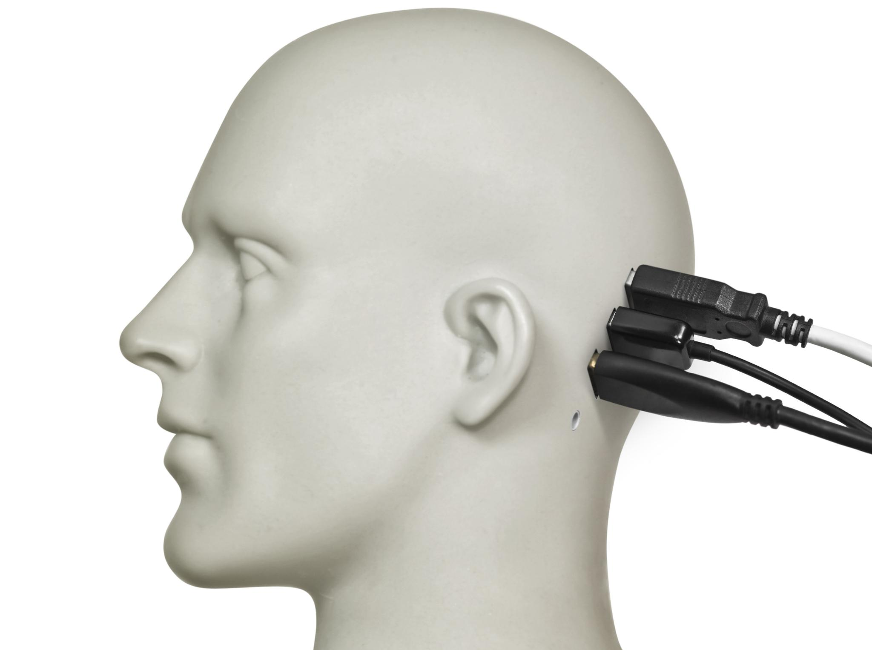
Sensory and physical impairments
Hearing Loss Challenges
  Hearing loss restricts traditional communication, often requiring devices like hearing aids or sign language.
Vision Impairments
  Visual impairments limit communication access, needing tools like braille and screen readers.
Speech Difficulties
  Speech impairments require alternative communication methods such as speech-generating devices.
Motor Limitations
  Motor impairments affect physical interaction, prompting use of adaptive technologies and assistive devices.

Slide 11

Emotional, psychological, and language-related challenges
Emotional Barriers
  Anxiety and mood disorders can prevent patients from expressing themselves openly to clinicians.
Language Differences
  Differences in language can create misunderstandings, requiring clinicians to use clear and simple communication.
Need for Empathy
  Clinicians must demonstrate empathy and sensitivity to overcome communication challenges and build trust.

Slide 12

Active listening and demonstrating empathy
Principles of Active Listening
  Active listening requires full concentration and understanding to respond effectively during communication.
Role of Empathy
  Empathy helps to build trust and rapport by understanding others’ feelings and perspectives.

Slide 13

Adapting verbal and non-verbal communication
Simplifying Language
  Use simple and clear language to ensure understanding and avoid confusion.
Using Gestures and Visual Cues
  Incorporate clear gestures and visual aids to complement verbal communication.
Adjusting Tone
  Modify tone of voice to match the listener's needs and preferences for better connection.

Slide 14
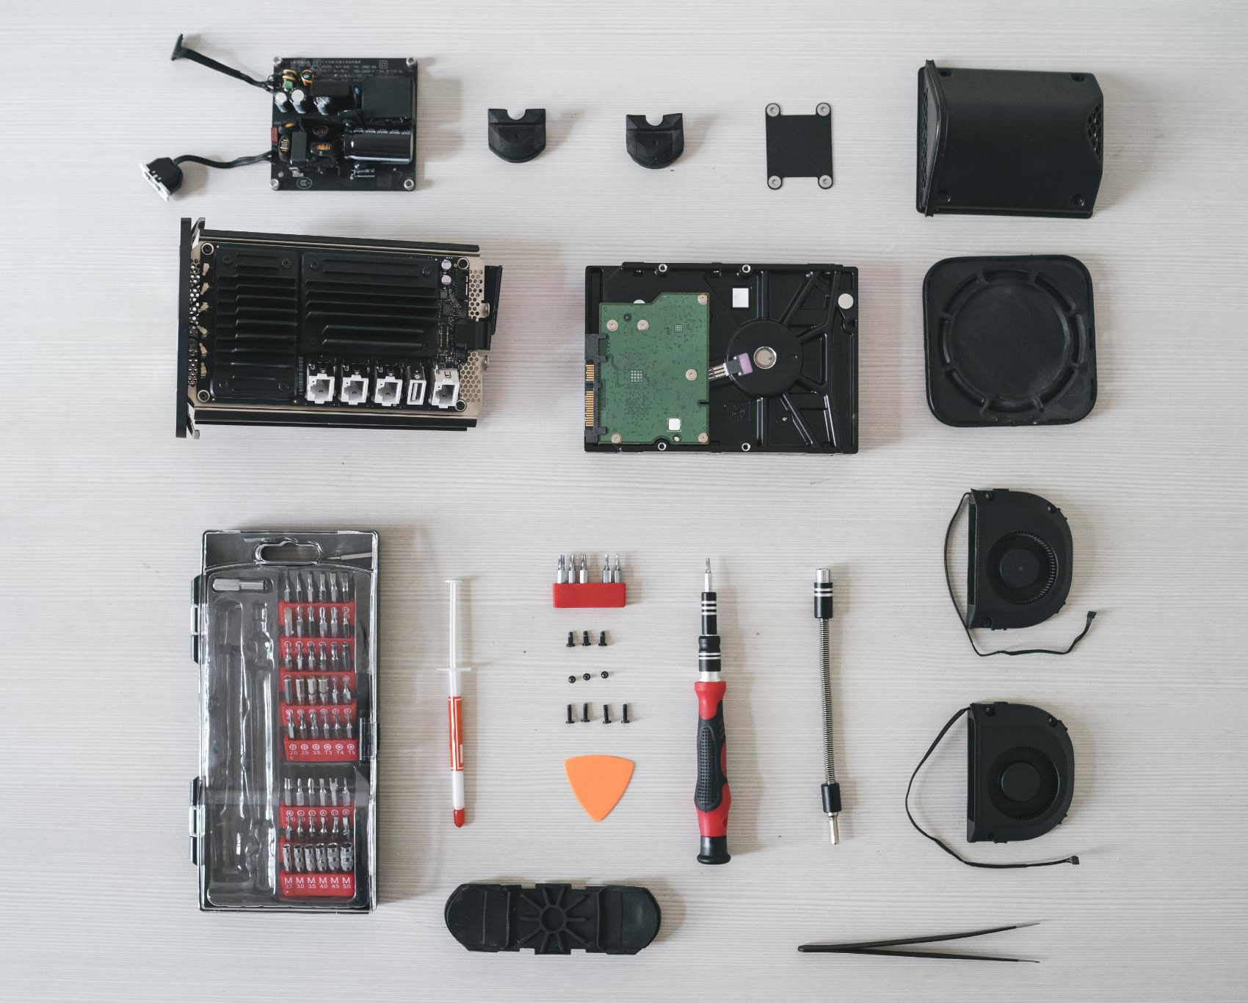
Augmentative and alternative communication (AAC) methods
AAC Tools and Techniques
  AAC uses pictures, symbols, and technology to support or replace spoken communication effectively.
Purpose of AAC
  AAC provides alternative ways for individuals to communicate when verbal speech is limited or unavailable.

Slide 15

Visual aids and communication boards
Use of Pictures and Symbols
  Pictures and symbols serve as essential tools for expressing needs and facilitating communication effectively.
Enhancing Interaction
  Communication boards increase participation by helping individuals understand and respond to instructions clearly.

Slide 16

Assistive technology: devices and software
Speech-Generating Devices
  Speech-generating tools help individuals with speech impairments communicate effectively and independently.
Specialised Communication Apps
  Specialised apps provide customised communication solutions for people with physical or speech challenges.

Slide 17

Role of interpreters and support staff
Bridging Communication Gaps
  Interpreters and communication assistants enable effective interaction between people with different communication needs.
Supporting Diverse Needs
  Support staff help individuals access information and services by providing tailored communication assistance.

Slide 18

Respecting autonomy and informed consent
Patient Understanding
  Patients must clearly understand their treatment options to make informed decisions about their care.
Respecting Patient Rights
  Respecting autonomy upholds patients' rights to choose or refuse medical treatments based on personal values.
Ethical Medical Practice
  Informed consent is a cornerstone of ethical practice ensuring transparent and honest communication in healthcare.

Slide 19

Cultural sensitivity and overcoming bias
Acknowledging Cultural Differences
  Recognising and respecting cultural diversity is essential for building trust in relationships.
Avoiding Assumptions
  Avoiding stereotypes and assumptions promotes clearer, effective communication across cultures.
Building Trust
  Trust grows when cultural differences are acknowledged and valued in conversations.

Slide 20

Professional boundaries and safeguarding
Importance of Clear Boundaries
  Clear boundaries help maintain professionalism and protect both patients and clinicians during interactions.
Ensuring Safety and Respect
  Boundaries ensure interactions are safe, respectful, and uphold the dignity of all parties involved.

Slide 21

Introduction to evidence-based frameworks
Structured Communication
  Frameworks offer organised methods for effective communication based on researched principles.
Research Foundation
  Evidence-based frameworks rely on research and best practices to guide communication strategies.

Slide 22

Using frameworks in clinical practice
Tailored Communication
  Frameworks enable personalised communication strategies to meet individual patient needs effectively.
Systematic Approach
  Using frameworks ensures a structured and consistent approach to clinical communication.

Slide 23
Case study: Selecting and justifying communication methods
Assessing Communication Needs
Identify the requirements and constraints of the situation to determine the best communication method.
Choosing Communication Methods
Select communication approaches that fit the complexity and audience of the case.
Justifying Communication Choices
Provide clear reasons explaining why selected methods are appropriate for effective information exchange.

Slide 24

Assessing cognitive and emotional status
Mental State Understanding
  Assessing cognitive and emotional status helps tailor communication to the patient's needs effectively.
Communication Adaptation
  Knowledge of patient's mental state guides the approach and complexity of interactions.

Slide 25

Modifying communication for physical limitations
Speech Impairment Adaptations
  Techniques like clear speech and alternative communication aids help people with speech impairments communicate effectively.
Hearing Impairment Accommodations
  Using sign language, hearing aids, and visual cues supports communication for those with hearing impairments.
Vision Impairment Adjustments
  Employing large print, braille, and audio materials enables effective communication for individuals with vision impairments.
Motor Impairment Support
  Adapting communication methods with assistive technologies aids people with motor impairments in interaction.

Slide 26

Tailoring communication to patient preferences
Preferred Language Use
  Using the patient’s preferred language enhances understanding and fosters trust.
Adapted Communication Format
  Presenting information in an accessible format ensures patients receive messages clearly.
Pace Adjustment
  Adjusting the pace of communication helps patients feel comfortable and engaged.

Slide 27

Self-assessment and reflective practice
Continuous Improvement
  Regular reflection fosters ongoing development in communication skills and personal growth.
Awareness of Biases
  Self-assessment helps identify and understand personal biases to improve interactions.

Slide 28

Recognising the impact on therapeutic relationships
Building Trust
  Effective communication fosters trust between healthcare providers and patients, enhancing cooperation.
Establishing Rapport
  Good communication helps develop rapport, making patients feel understood and comfortable.
Enhancing Patient Success
  Strong therapeutic relationships improve patient outcomes through better cooperation and adherence.

Slide 29

Improving patient outcomes through better communication
Reducing Misunderstandings
  Effective communication minimizes patient misunderstandings, ensuring clearer instructions and better care.
Increasing Adherence
  Good communication encourages patients to follow treatment plans, improving health outcomes.
Positive Recovery Influence
  Enhanced communication supports faster, more effective patient recovery and wellbeing.

Slide 30

Working with multidisciplinary teams
Importance of Clear Communication
  Effective communication ensures all team members understand goals and responsibilities.
Coordinated Care
  Collaboration among diverse experts leads to better coordinated and comprehensive care.
Shared Decision-Making
  Involving all stakeholders supports informed and collective decisions for optimal outcomes.

Slide 31
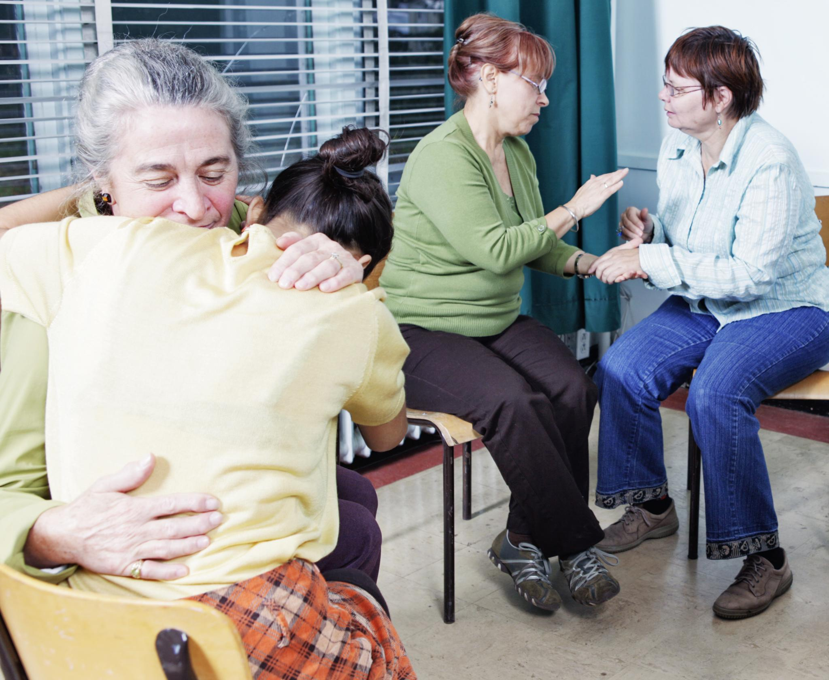
Engaging family and carers in communication
Support through Carer Involvement
  Involving family and carers enhances support to meet patient's holistic needs effectively.
Improved Understanding Beyond Clinics
  Engagement with carers aids understanding of patient needs outside clinical environments.

Slide 32

Ensuring continuity of care through shared information
Accurate Information Exchange
  Sharing precise patient data reduces medical errors and improves overall treatment quality.
Consistent Treatment
  Consistent information sharing ensures continuity and reliability in patient care over time.

Slide 33

Any Question

